Slide 1
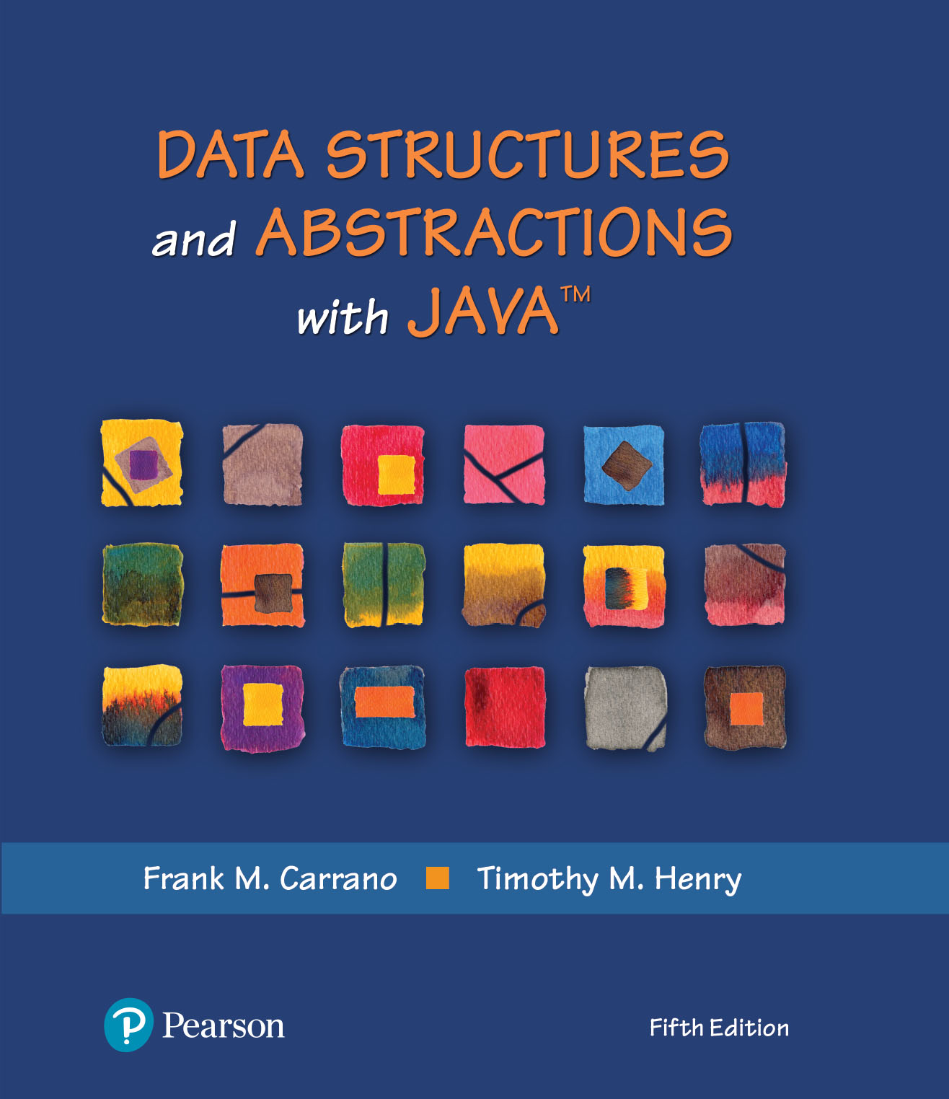
Module 13B - Hashing
Chapter 22 - Introducing Hashing
Chapter 23 – Hashing as Dictionary implementation

Slide 2
Video Notes
Hashing
https://mediaplayer.pearsoncmg.com/assets/secs-vn-ch22a-hashing
Resolving Collisions
https://mediaplayer.pearsoncmg.com/assets/secs-vn-ch22b-resolving-collisions
Efficiency of Hashing
https://mediaplayer.pearsoncmg.com/assets/secs-vn-ch23a-effciency-of-hashing
Implementing a Dictionary
https://mediaplayer.pearsoncmg.com/assets/secs-vn-ch23b-implementing-a-dictionary

Slide 3
Additional Resources
Hash Tables & Hash Functions
https://www.youtube.com/watch?v=KyUTuwz_b7Q&t=1s&ab_channel=ComputerScience
Hashing - Quadratic Probing
https://www.youtube.com/watch?v=tfXPEgYDQgI
Hashing - Double Hashing
https://www.youtube.com/watch?v=HcWxaVl1TII

Slide 4
What’s Hashing?
You are in a library, how would you look for the Gone with the Wind novel?
Hashing
Indexing algorithm
Same thinking as sorting
Impact to building a dictionary
Google Search
Supersize dictionary
https://www.google.com/search/howsearchworks/
Notes:
What we mean by “same thinking as sorting”

Slide 5
Hashing
Hash table can be used to find elements in a data structure quickly without performing a search
Determine an index into a table using only an entry’s search key
A hash function computes an integer value hash code from an object
A function, h, used to map a key, k, into a location, ip in the primary storage area
Hashing Function i_{p} = h(k)

Slide 6
Handy Parts Company | Example
Values
Handy Parts company
makes no more than 100 different parts
parts all have four digit numbers
How do we hash?
The following hash function (division method) can be used to store and retrieve parts in an array
Hash(key) = partNum % 100
[ 0 ]
[ 1 ]
[ 2 ]
[ 3 ]
[ 4 ]
.
.
.
null
4501
null
8903
8
10
[ 97]
[ 98]
[ 99]
7803
null
.
.
.
null
2298
3699
Why do we need to hash?
What if it makes 200 parts instead?
Notes:
We need to organize the parts so that we can retrieve it
Search vs. Look-up
Do you see the pattern, placing 4501 at a[1] and 2298 at a[98]?

Slide 7
Placing Elements
values
values
[ 0 ]
[ 1 ]
[ 2 ]
[ 3 ]
[ 4 ]
.
.
.
Place a mew element with part number 5502 in the array
So far, so good
[ 0 ]
[ 1 ]
[ 2 ]
[ 3 ]
[ 4 ]
.
.
.
null
4501
5502
null
4501
null
8903
8
10
[ 97]
[ 98]
[ 99]
7803
null
.
.
.
null
2298
3699
[ 97]
[ 98]
[ 99]
7803
null
.
.
.
null
2298
3699
Notes:
Placement of elements
Searching vs. look-up

Slide 8
Placing Elements
values
[ 0 ]
[ 1 ]
[ 2 ]
[ 3 ]
[ 4 ]
.
.
.
Next place part number
6702 in the array
Hash(key) = partNum % 100
6702 % 100 = 2
But values[2] is already
occupied.
COLLISION OCCURS
null
4501
5502
[ 97]
[ 98]
[ 99]
7803
null
.
.
.
null
2298
3699
Notes:
Where to store 6702?

Slide 9
Linear Probing (1 of 3)
values
[ 0 ]
[ 1 ]
[ 2 ]
[ 3 ]
[ 4 ]
.
.
.
null
4501
5502
One way is by linear probing by using a rehash function
(HashValue + 1) % 100
repeatedly until an empty location
is found for part number 6702.
[ 97]
[ 98]
[ 99]
7803
null
.
.
.
null
2298
3699
Notes:
Algorithms to handle collisions
Two categories of collision resolution techniques
Open addressing (e.g., linear probing)
Buckets

Slide 10
Linear Probing (2 of 3)
values
[ 0 ]
[ 1 ]
[ 2 ]
[ 3 ]
[ 4 ]
.
.
.
Still looking for a place for 6702
using the function
(HashValue + 1) % 100
null
4501
5502
[ 97]
[ 98]
[ 99]
7803
null
.
.
.
null
2298
3699

Slide 11
Linear Probing (3 of 3)
values
[ 0 ]
[ 1 ]
[ 2 ]
[ 3 ]
[ 4 ]
.
.
.
Part 6702 can be placed at
the location with index 4.
null
4501
5502
[ 97]
[ 98]
[ 99]
7803
null
.
.
.
null
2298
3699
Notes:
Part 6702 will finally be placed at values[4]

Slide 12
Hashing Function
Typical hash function performs two steps:
Convert search key to an integer – hash code
Compress hash code into the range of indices for hash table
Algorithm getHashIndex(phoneNumber)
// Returns an index to an array of tableSize elements.
i = last four digits of phoneNumber
return i % tableSize

Slide 13
Ideal Hashing | Adding(k,v) to a Dict
Algorithm add(key, value)
index = h(key)
hashTable[index] = value
Algorithm getValue(key)
index = h(key)
return hashTable[index]
Ideal algorithm for the dictionary operations that add and retrieve
Notes:
What do we mean by ideal?
Is it possible to achieve no collisions (time vs. space efficiency)

Slide 14
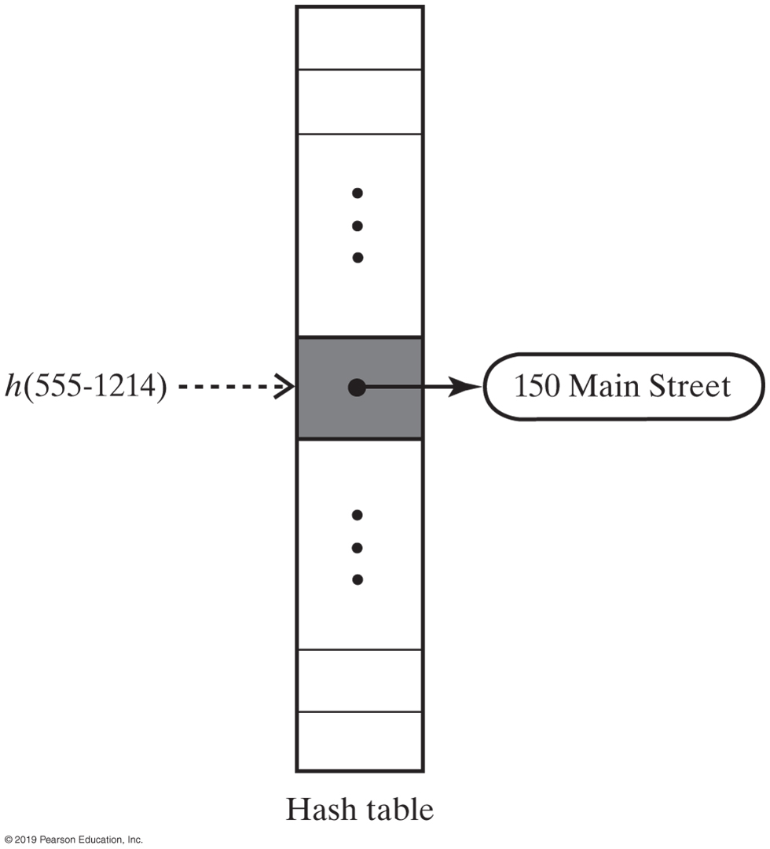
Address Finder | Another Example
How big (size of) should the hash table be?
Notes:
How big should the hash table be?

Slide 15
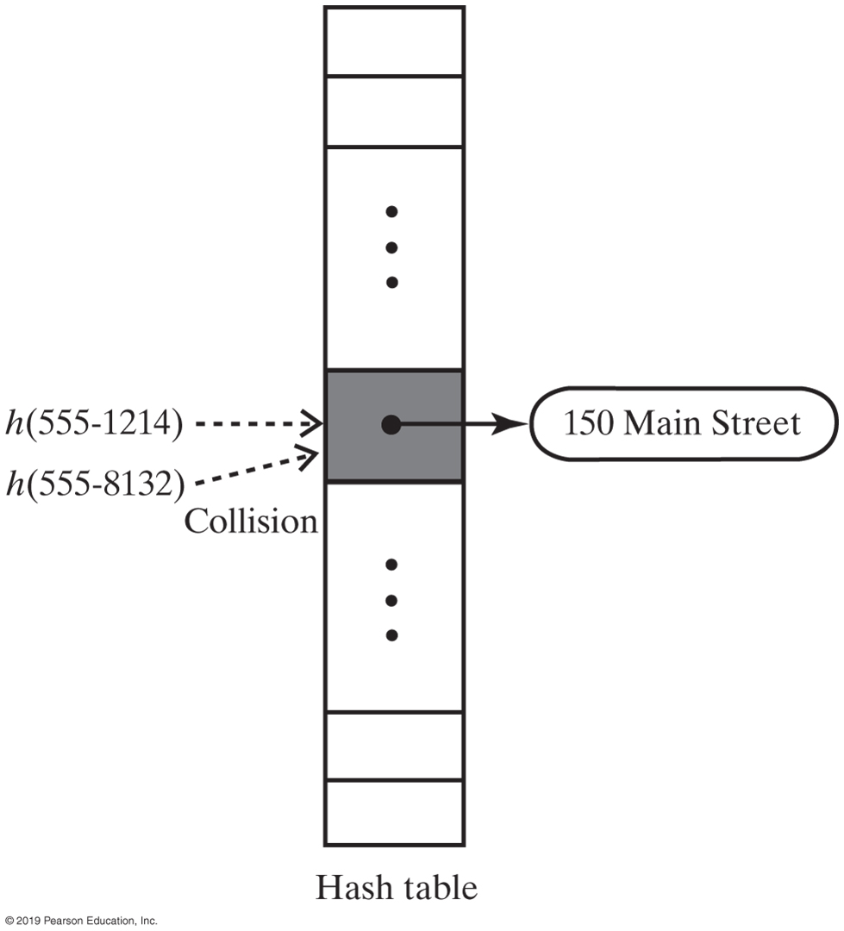
Hashing
Most hash functions aren't perfect
Causes a collision in the hash table
Need to handle situations where more than one search key mapping into a single index
For tableSize = 101
getHashIndex(555-1264) = 52
getHashIndex(555-8132) = 52 also!!!
A collision caused by the hash function h
Notes:
Why should tableSize = 101?

Slide 16
Hash Functions
A good hash function should
Minimize collisions
Be fast to compute
To reduce the chance of a collision
Choose a hash function that distributes entries uniformly throughout hash table

Slide 17
Activity: Linear Probing
Given the following values, show what the data structures would look like after insertions
27 53 13 10 138 109 49 174 26 24
Array:
0
1
2
3
4
5
6
7
8
9
10
11
12
13
27
Linear array of 10 elements
N = 13(Array size)
Where should 53 be placed? Why?
Notes:
We have 10 elements
How big should the table be?
N = 13 is just a size that we picked. It could have been 15 (or another number)
We are building a hash table for our data

Slide 18
Activity 1: Linear Probing
Given the following values, show what the data structures would look like after insertions
27 53 13 10 138 109 49 174 26 24
Data | Linear
13 | [0]
27 | [1]
53 | [2]
26 | [3]
109 | [5]
174 | [6]
138 | [8]
10 | [10]
49 | [11]
24 | [12]
Hashing

Slide 19
Hash Code for a Primitive type
If data type is int,
Use the key itself
For byte, short, char:
Cast as int
Other primitive types
Manipulate internal binary representations
Array index vs. Keys
Key was a phone number for the earlier example
Need to “convert” a phone number into an index (integer) placing it (phone) into hash table (array)

Slide 20
Computing Hash Codes
A hash code for a string
Using a character’s Unicode integer is common
“BCD” vs. “CBD” → could generate same hash code
Better approach
Multiply Unicode value of each character by factor based on character’s position
Sum values

Slide 21
Sample Strings & Hash Codes
Key (String) | Hash Code
"Adam" | 2035631
"Eve" | 700068
"Harry" | 69496448
"Jim" | 74478
"Joe" | 74656
"Juliet" | -2065036585
"Katherine" | 2079199209
"Sue" | 83491
Example: calcHashCode()
Notes:
Juliet
calHashCode()

Slide 22
Computing Hash Codes
Hash code for a string example:
Java code to do this | calcHashCode():
u0g^{n-1} + u1g^{n-2} + … + u^{n-2}g + un-1
int hash = 0;
int n = s.length();
for (int i = 0; i < n; i++)
hash = g * hash + s.charAt(i);

Slide 23
Hashing Function
Often non-numeric keys and negative keys are first preprocessed into a positive numeric pseudokey
The pseudokey, pk, is then used in the hashing function to determine ip
Preprocessing
algorithm
Hashing Function i_{p} = h(pk)
the primary storage area location, i_{p}
key, k
pseudo key, pk
23
23
23
23

Slide 24
Resolving Collisions
Collision
Hash function maps search key into a location in hash table already in use
Two choices
Use another location in the hash table (e.g., linear probing)
Change the structure of the hash table so that each array location can represent more than one value

Slide 25
Linear Probing
Linear probing
Resolves a collision during hashing by examining consecutive locations in hash table
Beginning at original hash index
Find the next available one
Table locations checked make up probe sequence
If probe sequence reaches end of table, go to beginning of table (circular hash table)

Slide 26
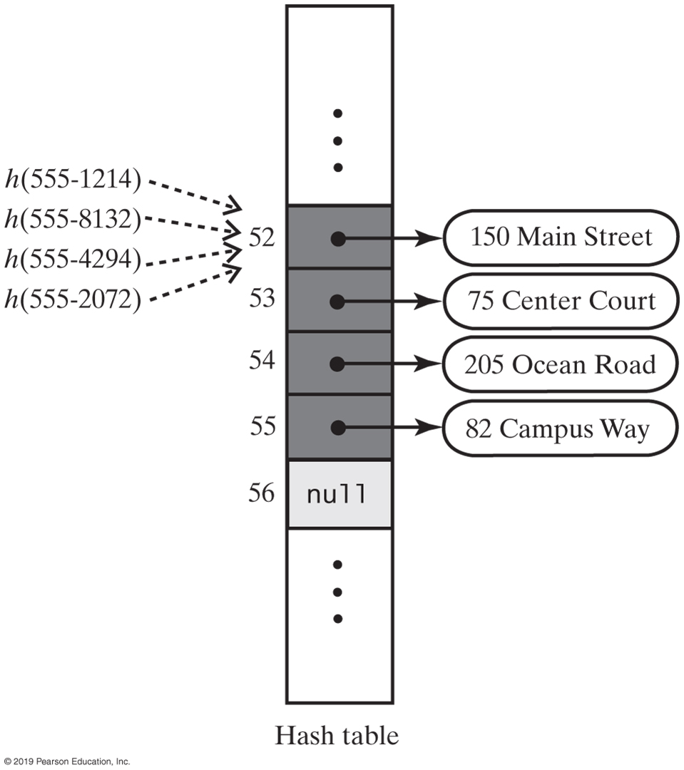
Linear Probing
The effect of linear probing after adding four entries whose search keys hash to the same index

Slide 27
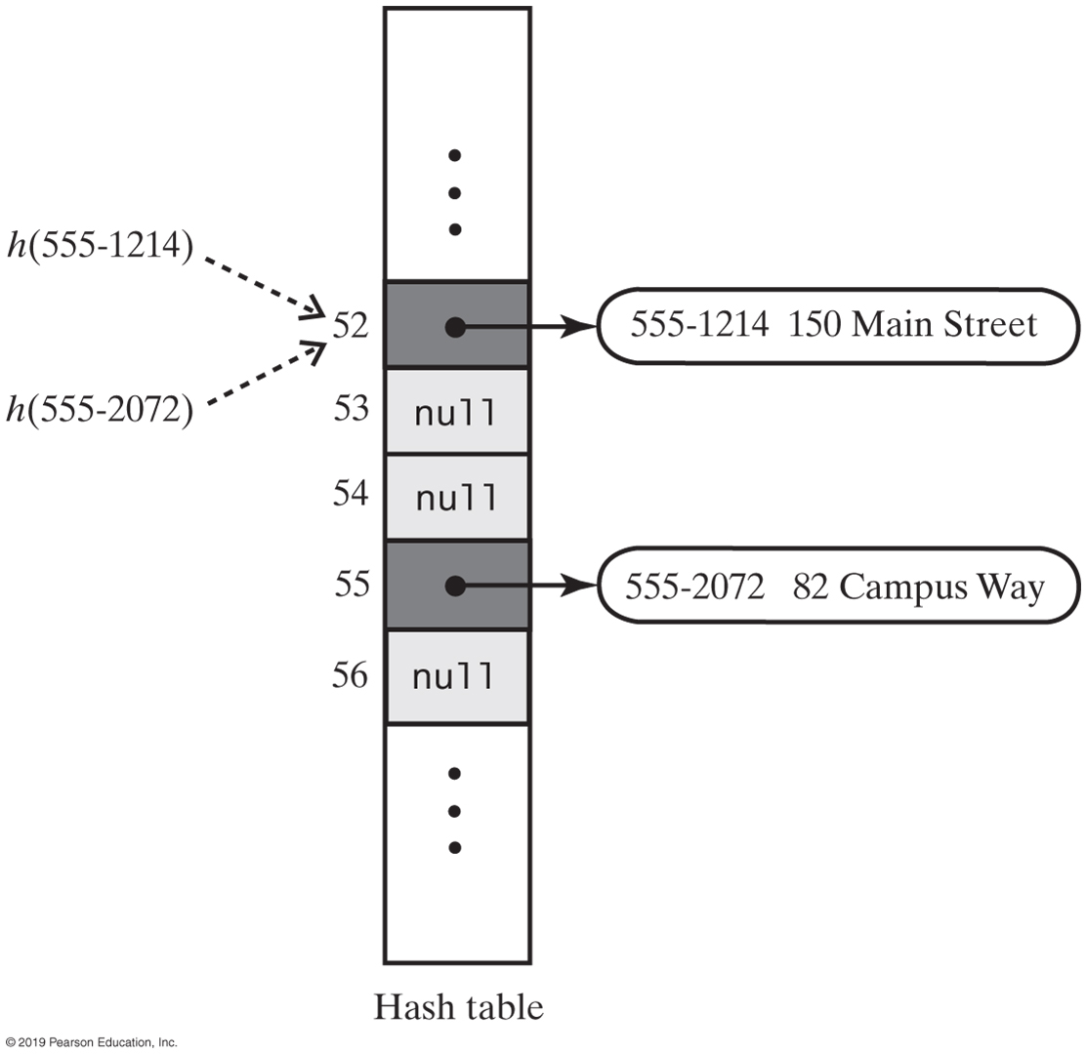
Linear Probing
A hash table if remove used null to remove entries

Slide 28
Resolving Collisions
Need to distinguish among three kinds of locations in the hash table
Occupied
location references an entry in the dictionary
Empty
location contains null and always has
Available
location’s entry was removed from the dictionary

Slide 29
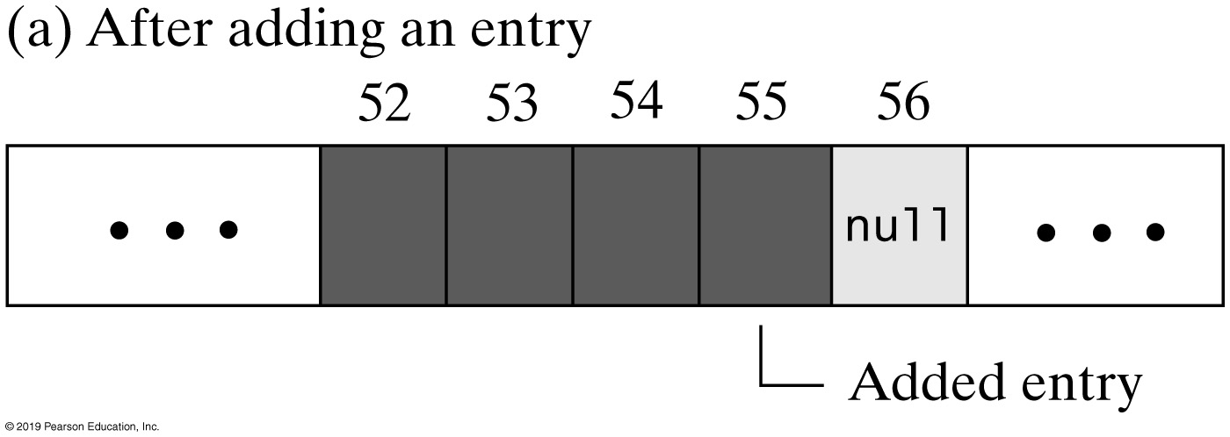
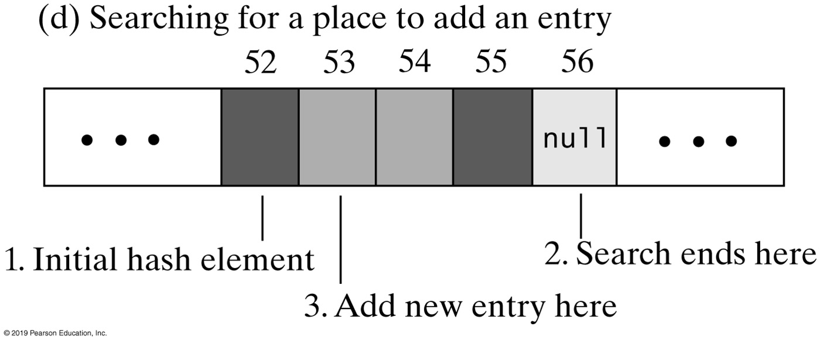
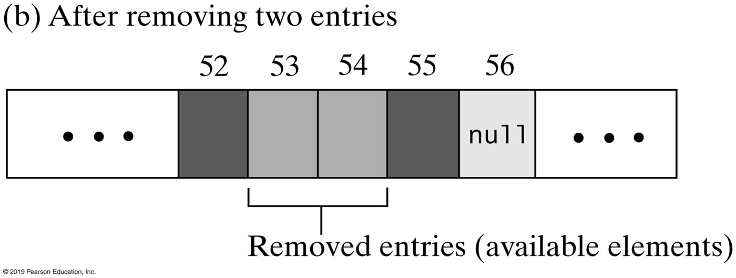
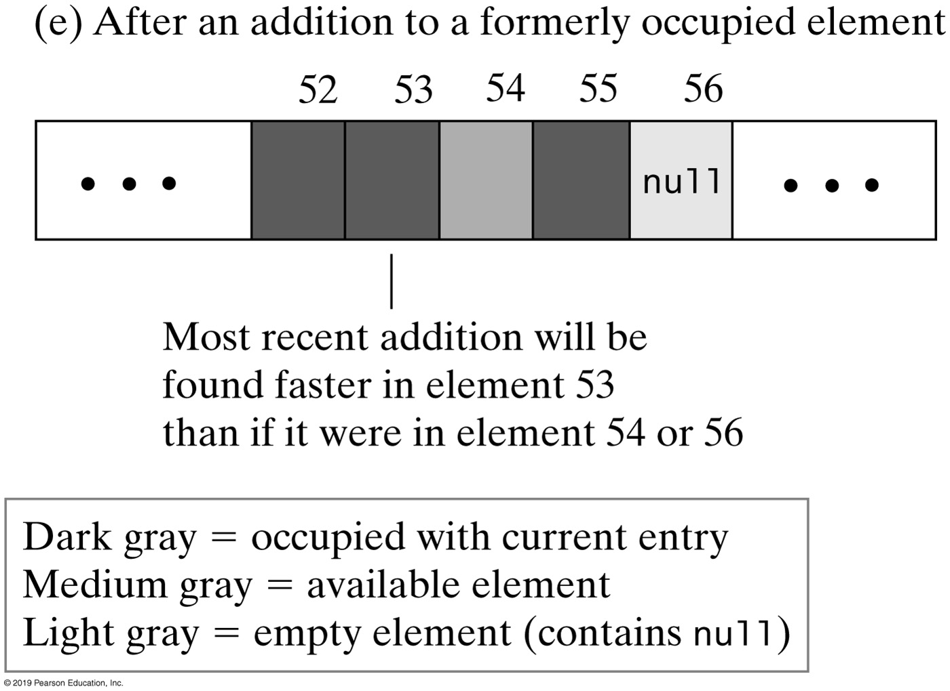
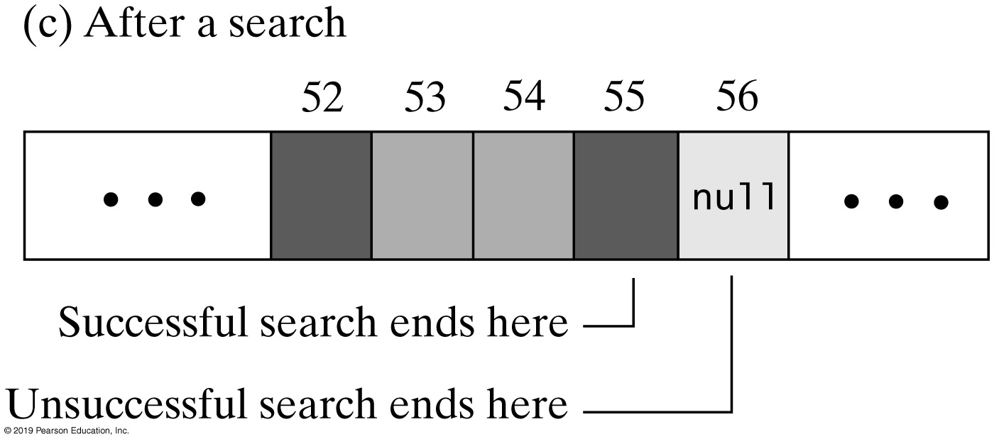
Linear Probing

Slide 30
Linear Probing Algorithm
Algorithm probe(index, key)
// Searches the probe sequence that begins at index. Returns the index of either the element
// containing key or an available element in the hash table.
while (key is not found and hashTable[index] is not null)
{
if (hashTable[index] references an entry in the dictionary)
{
if (the entry in hashTable[index] contains key)
Exit loop
else
index = next probe index
}
else // hashTable[index] is available
{
if (this is the first available element encountered)
availableStateIndex = index
index = next probe index
}
}
if (key is found or an available element was not encountered)
return index
else
return availableStateIndex // Index of first entry removed

Slide 31
Activity | Linear Probe Algorithm
// Precondition: checkIntegrity has been called.
private int linearProbe(int index, K key)
{
boolean found = false;
int availableStateIndex = −1; // Index of first element in available state
while ( !found && (hashTable[index] != null) )
{
if (hashTable[index] != AVAILABLE)
{
if (key.equals(hashTable[index].getKey()))
found = true; // Key found
else // Follow probe sequence
index = (index + 1) % hashTable.length; // Linear probing
}
else // Element in available state; skip it, but mark the first one encountered
{
// Save index of first element in available state
if (availableStateIndex == −1) availableStateIndex = index;
index = (index + 1) % hashTable.length; // Linear probing
} // end if
} // end while
// Assertion: Either key or null is found at hashTable[index]
if (found || (availableStateIndex == −1) )
return index; // Index of either key or null
else
return availableStateIndex; // Index of an available element
} // end linearProbe
Notes:
Take home activity | Get this code to work

Slide 32
Clustering
Collisions resolved with linear probing cause groups of consecutive locations in hash table to be occupied
Each group is called a cluster
What’s so bad about clustering?
Bigger clusters mean longer search times following collision
Notes:
Our goal | look up (search) at O(1), or as close to it as possible

Slide 33
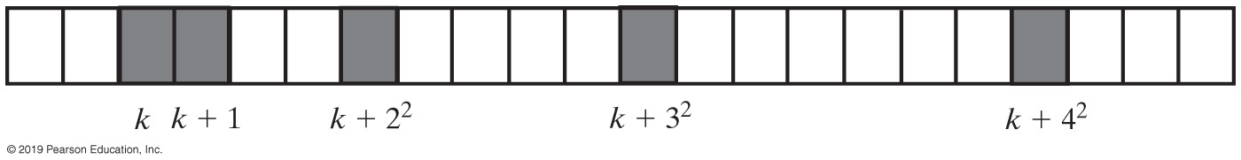
Open Addressing | Quadratic Probing
Linear probing looks at consecutive locations beginning at index k
Quadratic probing:
Considers the locations at indices k + j²
Uses the indices k, k + 1, k + 4, k + 9, …
A probe sequence of length five using quadratic probing
Notes:
Benefit of quadratic probing
Improve search time

Slide 34
Activity: Quadratic Probing
Given the following key values, show what the data structures would look like after insertions using quadratic probing
27 53 13 10 138 109 49 174 26 24
Linear array of 10 elements
N = 13
Show data structures with the following new key values instead
27 53 13 10 138 109 49 174 26 24 66
Linear array of 10 elements
N = 13
Notes:
Why N = 13? For now, it’s an arbitrary (magic) number
I can change the array size or the number of elements
Solution available on next slide

Slide 35
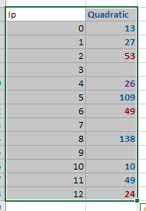
Activity: Quadratic Probing
Given the following key values, show what the data structures would look like after insertions
27 53 13 10 138 109 49 174 26 24 66
Linear array of 10 elements
N = 13

Slide 36
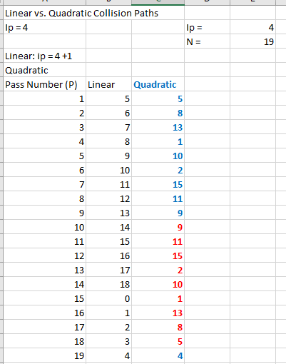
Linear vs. Quadratic Collision Paths
N: 19; Ip = 4
Collision paths for pass1, 2, …
Linear
ip = (4 + 1) % 19 = 5;
ip = (5 + 1) % 19 = 6; ……
Quadratic:
ip =(4 + 1*1) % 19 = 5;
ip =(4 + 2*2) % 19 = 8; ….
Repetitive addresses: in red; Clustering: same path for all synonyms of 4

Slide 37
Linear-Quotient (Array of Size N)
Minimal secondary clustering
only when q % N is the same for two synonyms (probably < 1/(N-1))
Minimal primary clustering
only when q == 1 (probability 1/(N-1))
No repetitive addressing (multiple accesses)
ip = (ip + offset) % N
where: offset = q if (q%N != 0) ; else offset = a 4k+3 prime
N is the array size, q = pk / N
Notes:
What is LQ?
Why LQ?

Slide 38
Activity: LQ Hashing Lab
1. Given the following key values, show what the data structures would look like after insertions
27 53 13 10 138 109 49 174 26 24
(no preprocessing necessary: p_{k} = key)
Linear array of 10 elements using division hashing and the linear-quotient collision path algorithm
N = 13, 4k+3 prime = 19
LQHashing:
1. ip = pk % N
2. q=pk / N
if (q%N != 0)
offset = q
else
offset = 4k+3 prime
3. While collisions:
ip’ = (ip + offset) % N
4. Set Array[ip]=key
27: 27%13=1
53: 53%13=1 q=53/13=4 (53+4)%13=5
13: 13%13=0
10: 10%13=10
138: 138%13=8
Array:
0
1
2
3
4
5
6
7
8
9
10
11
12
13
27
26
53
49
138
10
174
24
Notes:
Don’t look; solution on next slide

Slide 39
1. Given the following key values, show what the data structures would look like after insertions
27 53 13 10 138 109 49 174 26 24
(no preprocessing necessary: p_{k} = key)
Linear array of 10 elements using division hashing
and the linear-quotient collision path algorithm
N = 13, 4k+3 prime = 19
LQHashing:
1. ip = pk % N
2. q=pk/N
if (q%N != 0)
offset = q
else
offset = 4k+3 prime
3. While collisions:
ip’ = (ip + offset) % N
4. Set Array[ip]=key
27: 27%13=1
53: 53%13=1 q=53/13=4 (53+4)%13=5 26: 26%13=0 q=26/13=2 (26+2)%13=2
13: 13%13=0 24: 24%13=11 q24/13=1 (24+1)%13=12
10: 10%13=10
138: 138%13=8
109: 109%13=5 q=109/13=8 (109+8)%13=0 (117+8)%13=8 (125+8)%13=3
49: 49%13=10 q =49/13=3 (49+3)%13=0 (52+3)%13=3 (55+3)%13=6
174: 174%13=5 q=174/13=13, 13%13=0, so q=19 (174+19)%13=11
Array:
0
1
2
3
4
5
6
7
8
9
10
11
12
13
27
26
53
49
138
10
174
24

Slide 40
Open Addressing | Double Hashing
Linear probing and quadratic probing add increments to k to define a probe sequence
Both are independent of the search key
Double hashing uses a second hash function to compute these increments
https://www.geeksforgeeks.org/double-hashing/
https://www.geeksforgeeks.org/java-program-to-implement-hash-tables-with-double-hashing/

Slide 41
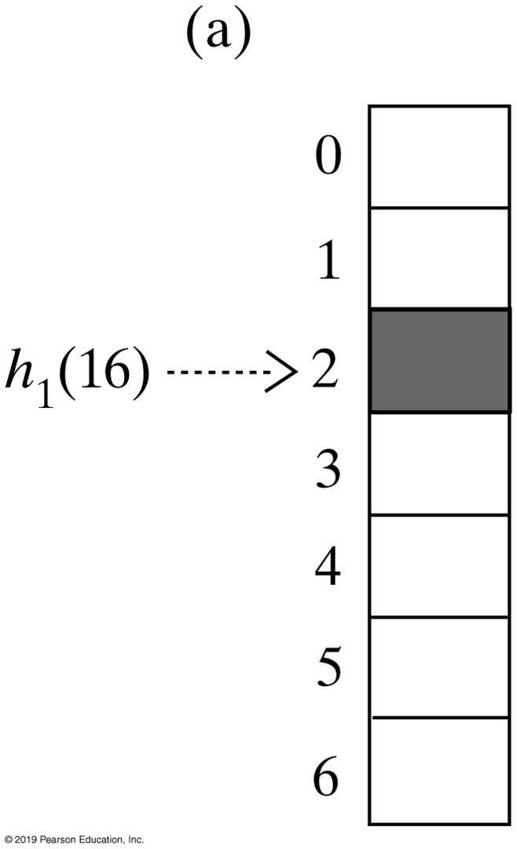
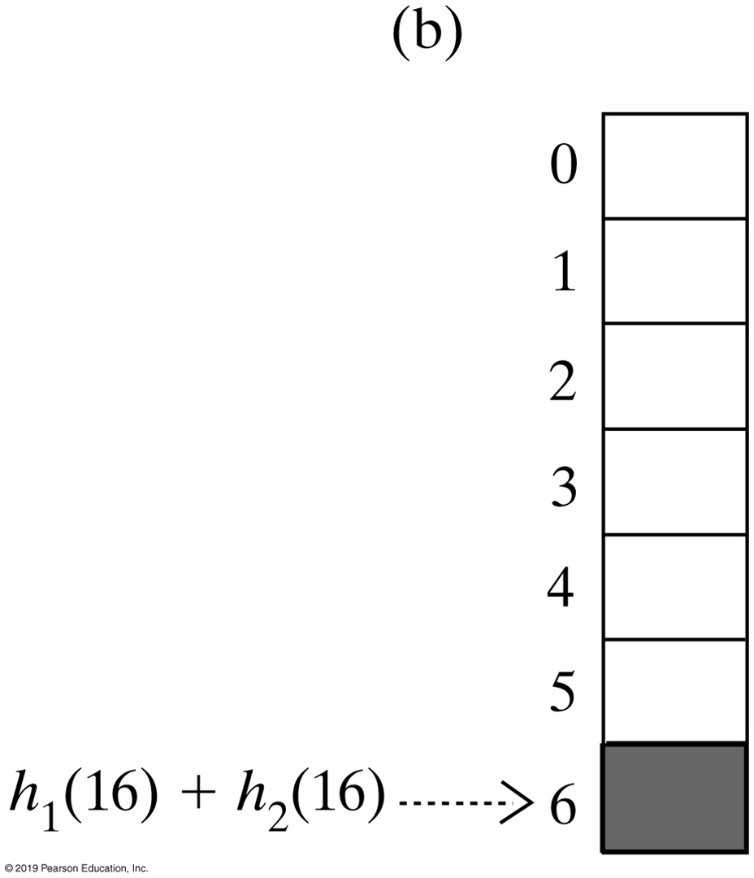
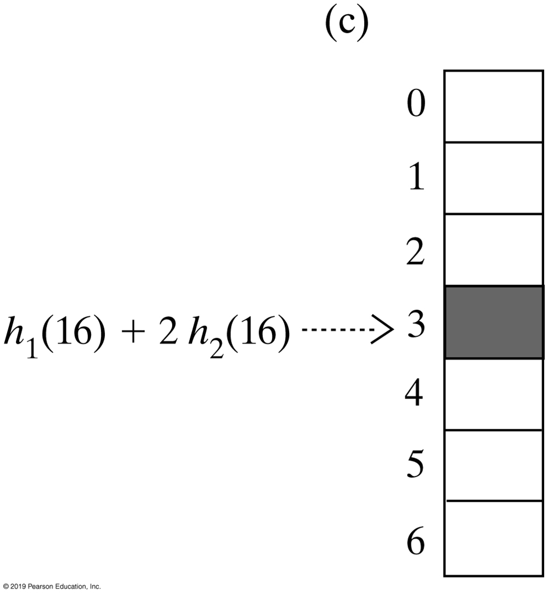
Open Addressing | Double Hashing
The first three elements in a probe sequence generated by double hashing for the search key 16

Slide 42
Open Addressing
In general, good approach
Potential problem
Recall each location is either occupied, empty, or available
Frequent additions and removals can result in no locations that are null
Thus searching a probe sequence will not work
Consider separate chaining as a solution

Slide 43
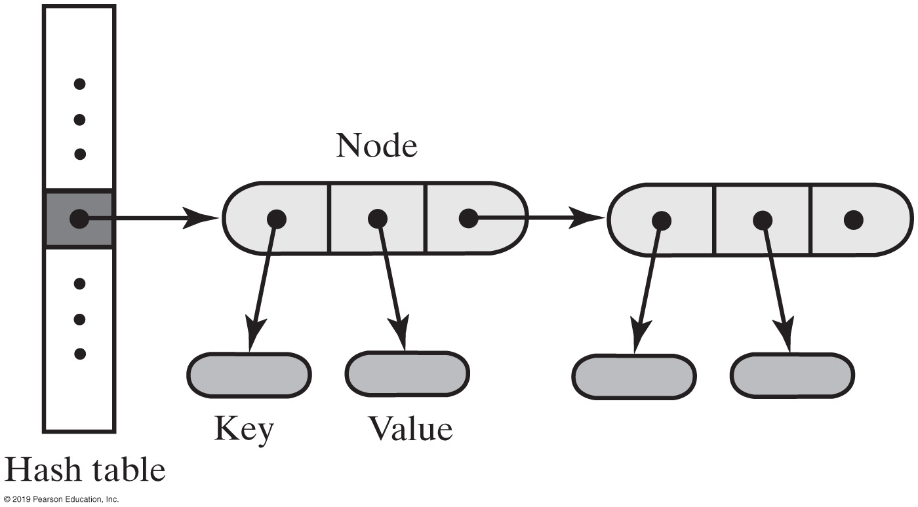
Separate Chaining (Buckets)
Alter the structure of the hash table
Each location can represent more than one value.
Such a location is called a bucket
Decide how to represent a bucket
list, sorted list
array
linked nodes
vector
A hash table for use with separate chaining; each bucket is a chain of linked nodes

Slide 44
Separate Chaining | Example
1. Given the following key values, show what the data structures would look like after insertions
27 53 13 10 138 109 49 174 26 24
(no preprocessing necessary: p_{k} = key)
Bucket hashing of 10 elements (N=10) ip = (p_{k}) % N
Array:
0
1
2
3
4
5
6
7
8
9
10
53
13
174
24
26
27
138
109
49
Notes:
Take home assignment
It’s all about retrievals

Slide 45
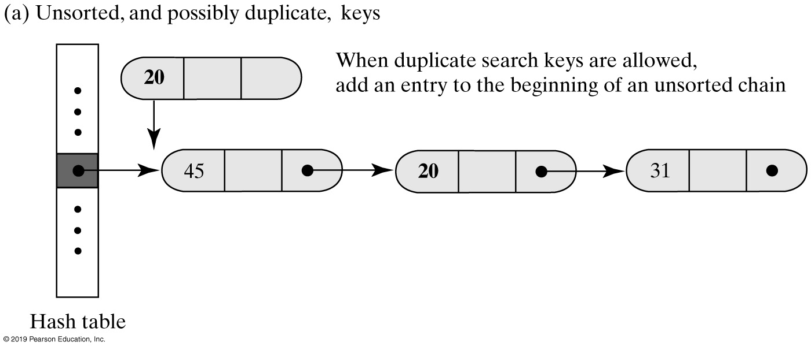
Separate Chaining
Inserting a new entry into a linked bucket according to the nature of the integer search keys

Slide 46
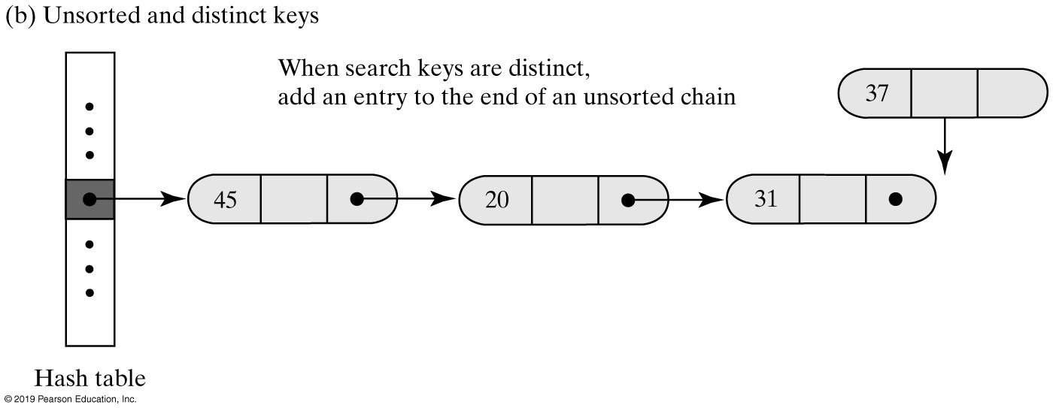
Separate Chaining
Inserting a new entry into a linked bucket according to the nature of the integer search keys

Slide 47
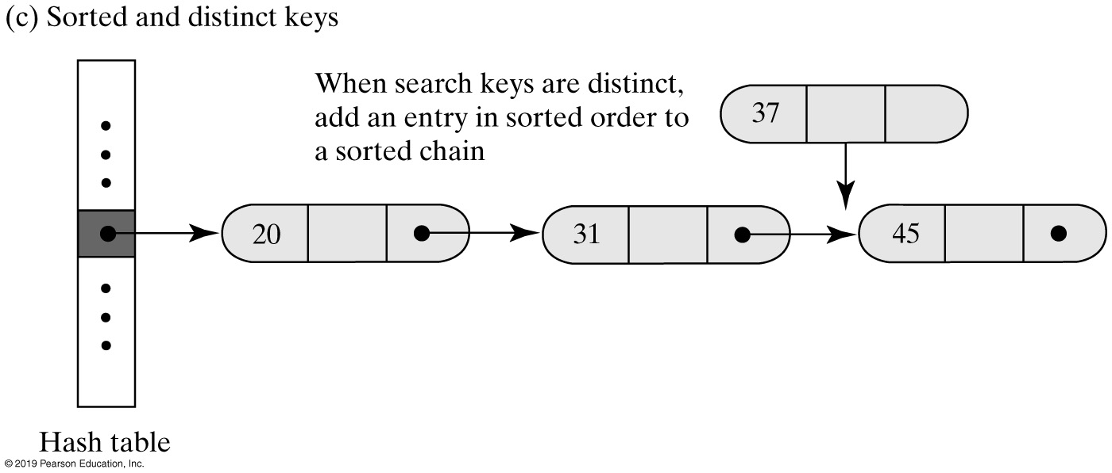
Separate Chaining
Inserting a new entry into a linked bucket according to the nature of the integer search keys

Slide 48
Objectives of Hash Function
Minimize collisions
Uniform distribution of hash values
Easy to calculate
Resolve any collisions
Source: https://www.youtube.com/watch?v=KyUTuwz_b7Q&list=RDCMUCSX3MR0gnKDxyXAyljWzm0Q&index=1
Notes:
Search vs. retrieval

Slide 49
Efficiency of Hashing
Observations about the time efficiency of these operations
Successful retrieval/removal has same efficiency as successful search
Unsuccessful retrieval/removal has same efficiency as unsuccessful search
Successful addition has same efficiency as unsuccessful search
Unsuccessful addition has same efficiency as successful search
Notes:
Search vs. retrieval

Slide 50
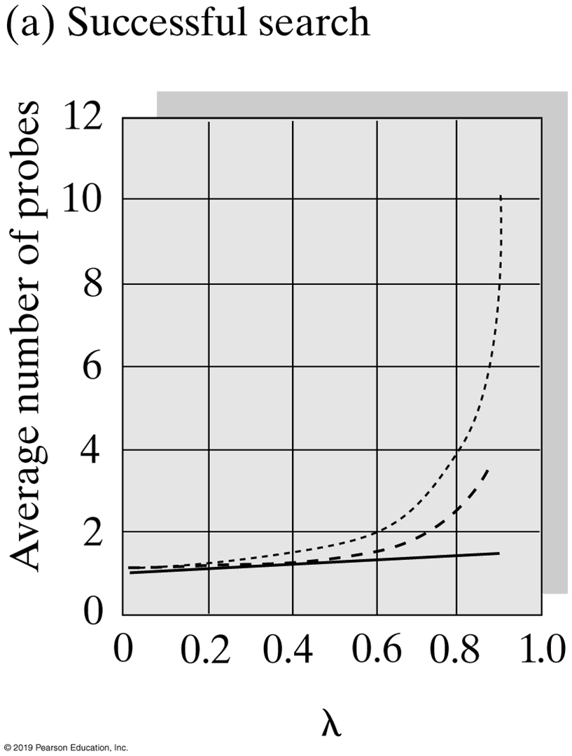
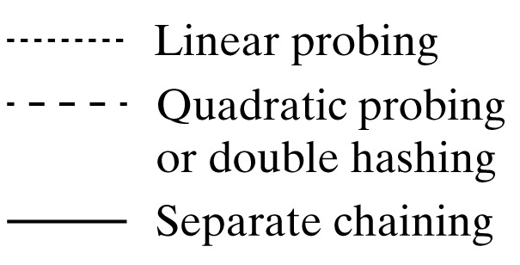
Comparing Schemes for Collision Resolution
The average number of comparisons required by a search of the hash table versus the load factor λ for four collision resolution techniques
Notes:
What is load factor?

Slide 51
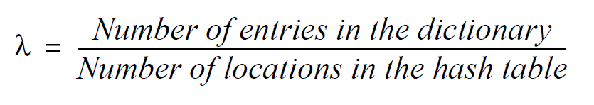
Load Factor
Definition of load factor (ratio)
Never negative
For open addressing, 1 ≥ λ
For separate chaining, λ has no maximum value
Restricting size of λ improves performance

Slide 52
Cost of Open Addressing
𝝀 | Unsuccessful Search | Successful Search
0.1 | 1.1 | 1.1
0.3 | 1.5 | 1.2
0.5 | 2.5 | 1.5
0.7 | 6.1 | 2.2
0.9 | 50.5 | 5.5
The average number of comparisons required by a search of the hash table for given values of the load factor λ when using linear probing
Notes:
What are we talking about here, 0.1 vs. 0.9?
λ= 0.9?

Slide 53
Quadratic Probing & Double Hashing
𝝀 | Unsuccessful Search | Successful Search
0.1 | 1.1 | 1.1
0.3 | 1.5 | 1.2
0.5 | 2.0 | 1.4
0.7 | 3.3 | 1.7
0.9 | 10.0 | 2.6
The average number of comparisons required by a search of the hash table for given values of the load factor λ when using either quadratic probing or double hashing

Slide 54
Cost of Separate Chaining
𝝀 | Unsuccessful Search | Successful Search
0.1 | 0.1 | 1.1
0.3 | 0.3 | 1.2
0.5 | 0.5 | 1.3
0.7 | 0.7 | 1.4
0.9 | 0.9 | 1.5
1.1 | 1.1 | 1.6
1.3 | 1.3 | 1.7
1.5 | 1.5 | 1.8
1.7 | 1.7 | 1.9
1.9 | 1.9 | 2.0
2.0 | 2.0 | 2.0
The average number of comparisons required by a search of the hash table for given values of the load factor λ when using separate chaining

Slide 55
Performance of Hashing
To maintain efficiency, restrict the size of λ as follows:
λ < 0.5 for open addressing
λ < 1.0 for separate chaining
Should the load factor exceed these bounds
Increase the size of the hash table

Slide 56
Rehashing
When the load factor λ becomes too large, resize the hash table
Compute the table’s new size
"Double" its present size
Increase the result to the next prime number
Use method add to add the current entries in dictionary to new hash table
Notes:
Doubling down is good, but is it the best choice?

Slide 57
Primary Storage Area Array Sizing
Based on an optimum loading factor, 0.75
Too high (≈1) → many collisions and therefore slow operations
Too low (< 0.75) → many unused array elements, therefore low density
A 4k+3 prime number, p4k+3
Using a prime results in less collisions
Array size, N, is the p4k+3 prime just above n/0.75
Open addressing (division hashing) function keeps array index in bounds

Slide 58
4k + 3 Primes
A prime, p, is a 4k+3 prime if there is an integer, k, such that p = 4k + 3
Test: set p = 4k+3, solve for k, is k an int?
For example, 857 and 859 are primes
857 is not a 4k+3 prime: k = (857 - 3) / 4 = 213.5
859 is a 4k+3 prime: k = (859 - 3) / 4 = 214.0

Slide 59
Example
5,129 “elements” will be stored in the structure,
n = 5,129
n / 0.75 = 6838.7, first prime above 6838 is 6841.
Is 6,841 a 4k+3 prime?
k = (6,841 - 3) / 4 = 1709.5 NO
Is next higher prime, 6,857 a 4k+3 prime?
k = (6,857 - 3) / 4 = 1713.5 NO
Is next higher prime, 6,863 a 4k+3 prime?
k = (6,863 - 3) / 4 = 1715.0 Yes
Array size N = 6,863
Notes:
To “hash” 5,129 elements, you want array size of 6,833
Our original examples, 10 elements with 13 as the array size (was that the best choice?)
When do you “increase” the array size, and by how much?

Slide 60
Prime Numbers Between 4000 and 7000
4001, 4003, 4007, 4013, 4019, 4021, 4027, 4049, 4051, 4057, 4073, 4079, 4091, 4093, 4099, 4111, 4127, 4129, 4133, 4139, 4153, 4157, 4159, 4177, 4201, 4211, 4217, 4219, 4229, 4231, 4241, 4243, 4253, 4259, 4261, 4271, 4273, 4283, 4289, 4297, 4327, 4337, 4339, 4349, 4357, 4363, 4373, 4391, 4397, 4409, 4421, 4423, 4441, 4447, 4451, 4457, 4463, 4481, 4483, 4493, 4507, 4513, 4517, 4519, 4523, 4547, 4549, 4561, 4567, 4583, 4591, 4597, 4603, 4621, 4637, 4639, 4643, 4649, 4651, 4657, 4663, 4673, 4679, 4691, 4703, 4721, 4723, 4729, 4733, 4751, 4759, 4783, 4787, 4789, 4793, 4799, 4801, 4813, 4817, 4831, 4861, 4871, 4877, 4889, 4903, 4909, 4919, 4931, 4933, 4937, 4943, 4951, 4957, 4967, 4969, 4973, 4987, 4993, 4999, 5003, 5009, 5011, 5021, 5023, 5039, 5051, 5059, 5077, 5081, 5087, 5099, 5101, 5107, 5113, 5119, 5147, 5153, 5167, 5171, 5179, 5189, 5197, 5209, 5227, 5231, 5233, 5237, 5261, 5273, 5279, 5281, 5297, 5303, 5309, 5323, 5333, 5347, 5351, 5381, 5387, 5393, 5399, 5407, 5413, 5417, 5419, 5431, 5437, 5441, 5443, 5449, 5471, 5477, 5479, 5483, 5501, 5503, 5507, 5519, 5521, 5527, 5531, 5557, 5563, 5569, 5573, 5581, 5591, 5623, 5639, 5641, 5647, 5651, 5653, 5657, 5659, 5669, 5683, 5689, 5693, 5701, 5711, 5717, 5737, 5741, 5743, 5749, 5779, 5783, 5791, 5801, 5807, 5813, 5821, 5827, 5839, 5843, 5849, 5851, 5857, 5861, 5867, 5869, 5879, 5881, 5897, 5903, 5923, 5927, 5939, 5953, 5981, 5987, 6007, 6011, 6029, 6037, 6043, 6047, 6053, 6067, 6073, 6079, 6089, 6091, 6101, 6113, 6121, 6131, 6133, 6143, 6151, 6163, 6173, 6197, 6199, 6203, 6211, 6217, 6221, 6229, 6247, 6257, 6263, 6269, 6271, 6277, 6287, 6299, 6301, 6311, 6317, 6323, 6329, 6337, 6343, 6353, 6359, 6361, 6367, 6373, 6379, 6389, 6397, 6421, 6427, 6449, 6451, 6469, 6473, 6481, 6491, 6521, 6529, 6547, 6551, 6553, 6563, 6569, 6571, 6577, 6581, 6599, 6607, 6619, 6637, 6653, 6659, 6661, 6673, 6679, 6689, 6691, 6701, 6703, 6709, 6719, 6733, 6737, 6761, 6763, 6779, 6781, 6791, 6793, 6803, 6823, 6827, 6829, 6833, 6841, 6857, 6863, 6869, 6871, 6883, 6899, 6907, 6911, 6917, 6947, 6949, 6959, 6961, 6967, 6971, 6977, 6983, 6991, 6997
Notes:
Doubling down is good, but is it the best choice?

Slide 61
LQ Hash (Java Standard Library)
Runs at the optimum loading factor
Its primary storage size, N, is the first 4k+3 prime above n /0.75 (n is the maximum nodes to be stored)
Its operation algorithms use
Folding preprocessing, the Division Hashing function, and the Linear-Quotient collision algorithm
https://www.baeldung.com/folding-hashing-technique
Its implementation is fairly straight forward
Its performance is always excellent
Notes:
Doubling down is good, but is it the best choice?

Slide 62
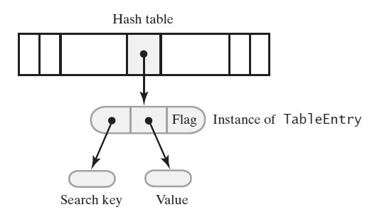
Dictionary Implementation (Uses Hashing)
A hash table and one of its entry objects

Slide 63
Dictionary Implementation (Uses Hashing)
private static class TableEntry<S, T>
{
private S key;
private T value;
private States state; // Flags whether this entry is in the hash table
private enum States {CURRENT, REMOVED} // Possible values of state
private TableEntry(S searchKey, T dataValue)
{
key = searchKey;
value = dataValue;
state = States.CURRENT;
} // end constructor
// method implementations go here
} // end TableEntry
Private class TableEntry, make it internal to the dictionary class

Slide 64
Dictionary that Uses Hashing (Part 1)
public class HashedDictionary<K, V> implements DictionaryInterface<K, V>
{
// The dictionary:
private int numberOfEntries;
private static final int DEFAULT_CAPACITY = 5; // Must be prime
private static final int MAX_CAPACITY = 10000;
// The hash table:
private Entry<K, V>[] hashTable;
private int tableSize; // Must be prime
private static final int MAX_SIZE = 2 * MAX_CAPACITY;
private boolean integrityOK = false;
private static final double MAX_LOAD_FACTOR = 0.5; // Fraction of
// hash table that can be filled
protected final Entry<K, V> AVAILABLE = new Entry<>(null, null);
public HashedDictionary()
{
this(DEFAULT_CAPACITY); // Call next constructor
} // end default constructor
An outline of the class HashedDictionary

Slide 65
class HashedDictionary
public HashedDictionary(int initialCapacity)
{
initialCapacity = checkCapacity(initialCapacity);
numberOfEntries = 0; // Dictionary is empty
// Set up hash table:
// Initial size of hash table is same as initialCapacity if it is prime;
// otherwise increase it until it is prime size
int tableSize = getNextPrime(initialCapacity);
checkSize(tableSize); // Check that size is not too large
// The cast is safe because the new array contains null entries
@SuppressWarnings("unchecked")
Entry<K, V>[] temp = (Entry<K, V>[])new Entry[tableSize];
hashTable = temp;
integrityOK = true;
} // end constructor
/* Implementations of methods in DictionaryInterface are here. . . .
Implementations of private methods are here. . . . */
protected final class Entry<S, T>
{
/* . . . */
} // end Entry
} // end HashedDictionary

Slide 66
add
Algorithm add(key, value)
// Adds a new key-value entry to the dictionary. If key is already in the dictionary,
// returns its corresponding value and replaces it in the dictionary with value.
if ((key == null) or (value == null))
Throw an exception
index = getHashIndex(key)
if (key is not found)
{ // Add entry to hash table
hashTable[index] = new Entry(key, value)
numberOfEntries++
oldValue = null
}
else // Search key is in table; replace and return entry’s value
{
oldValue = hashTable[index].getValue()
hashTable[index].setValue(value)
}
// Ensure that hash table is large enough for another addition
if (hash table is too full)
Enlarge hash table
return oldValue

Slide 67
enlargeHashTable
private void enlargeHashTable()
{
Entry<K, V>[] oldTable = hashTable;
int oldSize = hashTable.length;
int newSize = getNextPrime(oldSize + oldSize);
checkSize(newSize);
// The cast is safe because the new array contains null entries
@SuppressWarnings("unchecked")
Entry<K, V>[] temp = (Entry<K, V>[])new Entry[newSize];
hashTable = temp;
numberOfEntries = 0; // Reset number of dictionary entries, since
// it will be incremented by add during rehash
// Rehash dictionary entries from old array to the new and bigger array;
// skip elements that contain null or AVAILABLE
for (int index = 0; index < oldSize; index++)
{
if ( (oldTable[index] != null) && oldTable[index] != AVAILABLE )
add(oldTable[index].getKey(), oldTable[index].getValue());
} // end for
} // end enlargeHashTable

Slide 68
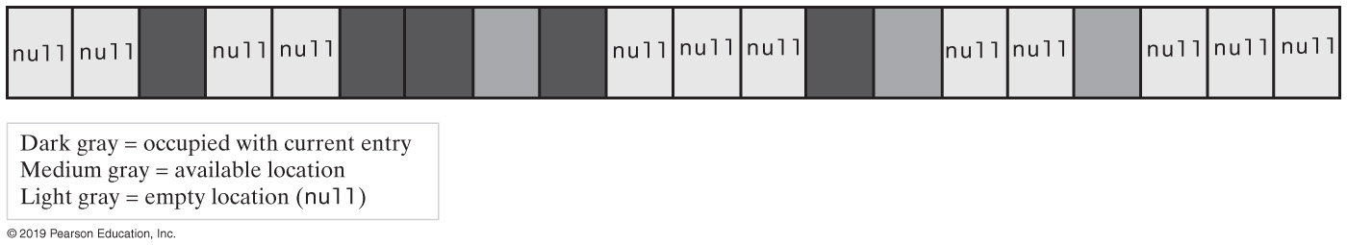
Hash Tables & Iterators
A hash table containing occupied elements, available elements, and null values

Slide 69
Hash Tables and Iterators (Part 1)
private class KeyIterator implements Iterator<K>
{
private int currentIndex; // Current position in hash table
private int numberLeft; // Number of entries left in iteration
private KeyIterator()
{
currentIndex = 0;
numberLeft = numberOfEntries;
} // end default constructor
public boolean hasNext()
{
return numberLeft > 0;
} // end hasNext
public void remove()
{
throw new UnsupportedOperationException();
} // end remove

Slide 70
Hash Tables and Iterators (Part 2)
public K next()
{
K result = null;
if (hasNext())
{
// Skip table locations that do not contain a current entry
while ( (hashTable[currentIndex] == null) ||
(hashTable[currentIndex] == AVAILABLE) )
{
currentIndex++;
} // end while
result = hashTable[currentIndex].getKey();
numberLeft--;
currentIndex++;
}
else
throw new NoSuchElementException();
return result;
} // end next
} // end KeyIterator

Slide 71
Class HashMap (Java Class Library)
Hash table is a collection of buckets
Each bucket contains several entries
Variety of constructors provided
Default maximum load factor of 0.75
When limit exceeded, size of table increased by rehashing
Possible to avoid rehashing by setting number of buckets initially larger

Slide 72
Class HashSet (Java Class Library)
Implements the interface java.util.Set
HashSet uses an instance of the class HashMap
Variety of constructors provided in class

Slide 73
Class HashTable (Java Class Library)
Hybrid dynamic hashed structure
Uses expandable linked lists to resolve collisions
Primary storage also expands when the loading factor exceeds a specified maximum
Unencapsulated generic structure
Key can be any type of object
Key class should overwrite the method equals and hashCode (the String and wrapper classes do this)
Hashtable’s operation methods invoke these methods

Slide 74
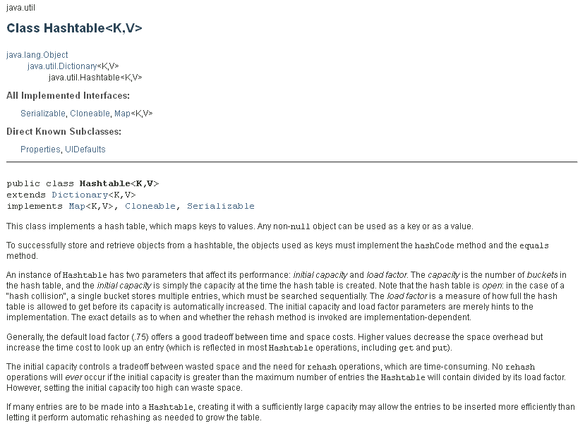

Slide 75
Java’s hashCode()
Java’s base class Object has a method hashCode that returns an integer hash code
A class should define its own version of hashCode
https://www.geeksforgeeks.org/override-equalsobject-hashcode-method/

Slide 76
Hash Code Contract
Java equals() and hashCode() Contracts
https://www.baeldung.com/java-equals-hashcode-contracts
Whenever it is invoked on the same object more than once during an execution of a Java application, the hashCode method must consistently return the same integer, provided no information used in equals comparisons on the object is modified. This integer need not remain consistent from one execution of an application to another execution of the same application
If two objects are equal according to the equals(Object) method, then calling the hashCode method on each of the two objects must produce the same integer result.
It is not required that if two objects are unequal according to the equals(java.lang.Object) method, then calling the hashCode method on each of the two objects must produce distinct integer results. However, the programmer should be aware that producing distinct integer results for unequal objects may improve the performance of hash tables.
As much as is reasonably practical, the hashCode method defined by class Object does return distinct integers for distinct objects. (This is typically implemented by converting the internal address of the object into an integer, but this implementation technique is not required by the JavaTM programming language.)
Notes:
MUST DO | https://www.baeldung.com/java-hashcode

